Slide 1
System Development Methods CT00046-3-2
State Diagram
Tutorial 11 – Part 1

Slide 2
Tutorial
Create a state diagram for the ‘Application’ object in the SAS case study.
See the next slide to find out the proposed SAS class diagram

Slide 3
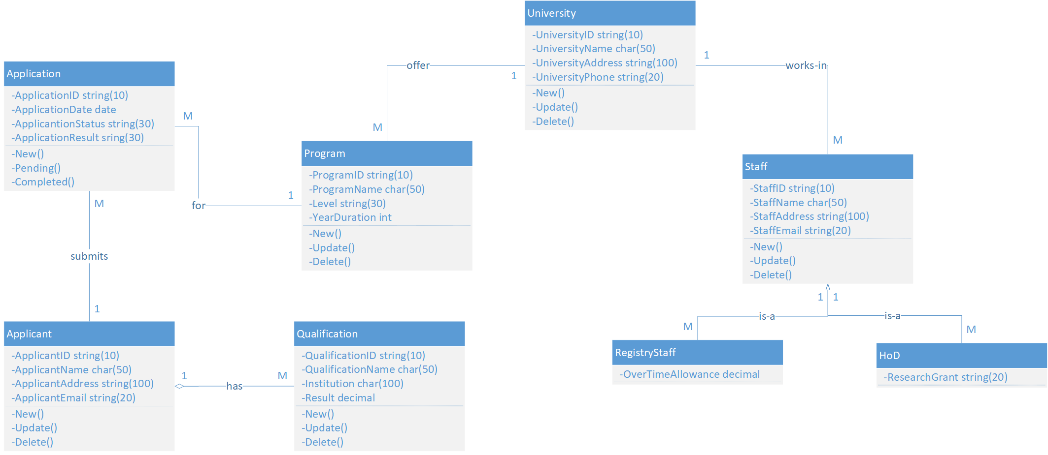
The Proposed Class Diagram for the SAS ‘Application’ is one of the objects in the SAS, also shown in the proposed class diagram.

Slide 4
Student Application System (SAS) Case Study
You would like to create an online portal for prospective students to apply for programs at universities. There will be a list of universities in the portal for students to select from. Each university offers several programs of study. Applicants should be able to create a profile of themselves. When they are interested in a program, they will submit an application. The registry staff at the related university will first validate that the required information in the application. If the application is valid, the head of the department (HOD) of the program will approve or reject the application.

Slide 5
State Diagram
A state diagram is a behavioral diagram that describes the behavior of a single object in response to a series of events in a system.
An object in a system can be a person, department, or any object/thing that will use/interact with the system.
A state diagram shows the actual changes in state, not the processes or commands that created those changes.
A state diagram focuses on a set of attributes of a single abstraction (object).

Slide 6
State Diagram Symbols
States Represent situations in your system. You can easily illustrate a state by using a rectangle with rounded corners.
A simple state
A state with internal activities

Slide 7
State Diagram Symbols
Transition A solid arrow represents the path between different states of an object. Label the transition with the event that triggered it and the action that results from it. A state can have a transition that points back to itself.
Initial State A filled circle followed by an arrow represents the object's initial state.
Final State An arrow pointing to a filled circle nested inside another circle represents the object's final state.

Slide 8
Let’s create a state diagram for the ‘Application’ object in the SAS case study.
Use of system modelling tool e.g., Ms. Visio, DIA, draw.io, etc.

